Slide 1

Introduction To Docker !
Noor Mustafa Rajpar bscs IBA

Slide 2
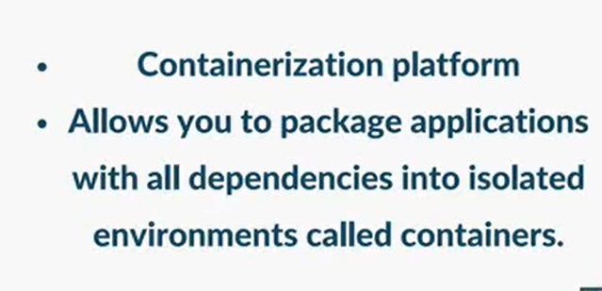
What Is Docker?

Slide 3
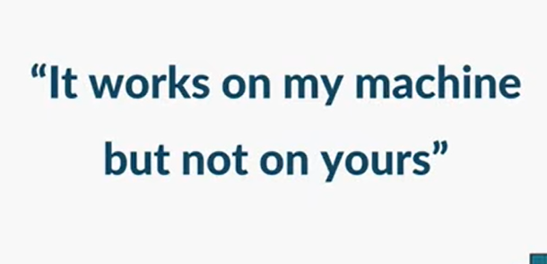
Problem Without Docker?

Slide 4
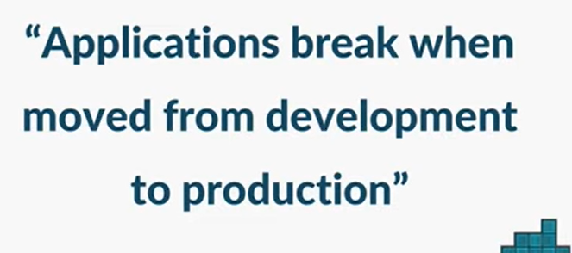
Problem Without Docker?

Slide 5
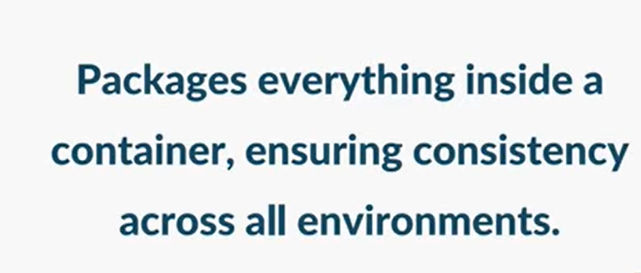
Solution ! Docker..

Slide 6
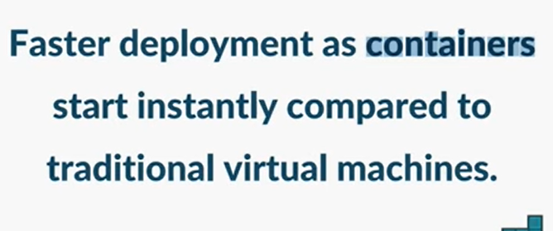
Solution ! Docker..

Slide 7
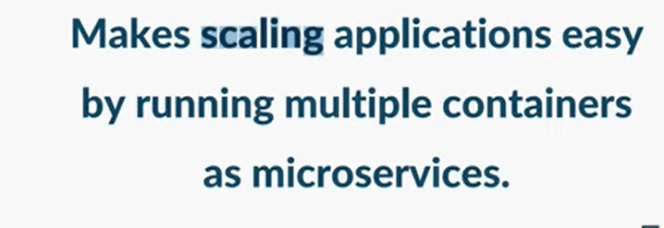
Solution ! Docker..

